Slide 1
DFE
FILTER
ARRAY
By:
Mustafa Tamer Mansour EL-Sherif
Amira Atef Ismaeil EL-Komy
Omar Ayoub

Slide 2
OUR
AGENDA
PROJECT OVERVIEW
SYSTEM ARCHIECTURE
FPGA & FILTER INTEGERATION
TESTING AND VERIFICATION
RESULTS AND CONCLUSION

Slide 3
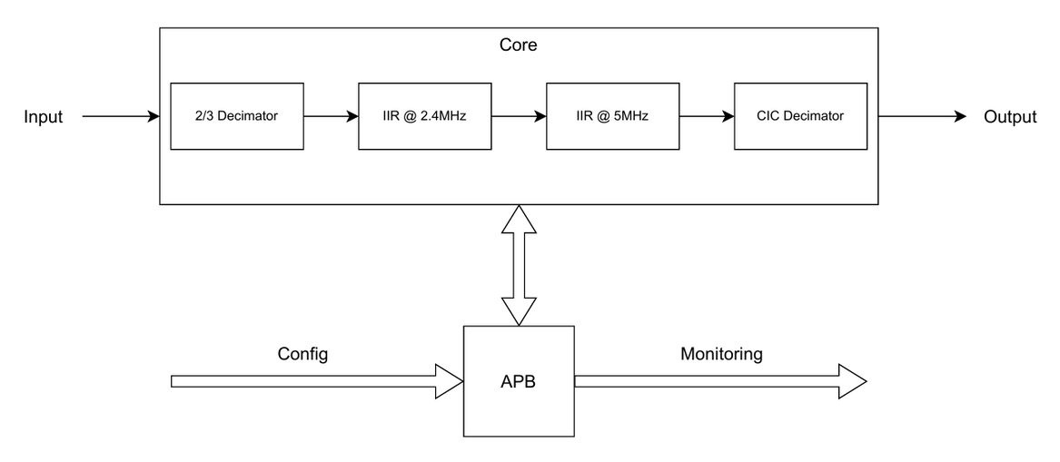
PROJECT
OVERVIEW
FRACTIONAL POLYPHASE DECIMATOR (9 MHZ → 6 MHZ)
Dual 2nd-order IIR notch filters (2.4 MHz, 5.0 MHz)
Configurable CIC decimator (D = 2, 4, 8, 16)
Control, status, and debug/probe registers

Slide 4
SYSTEM
ARCHITECTURE
HIGH LEVEL DESIGN AND MODELING

Slide 5
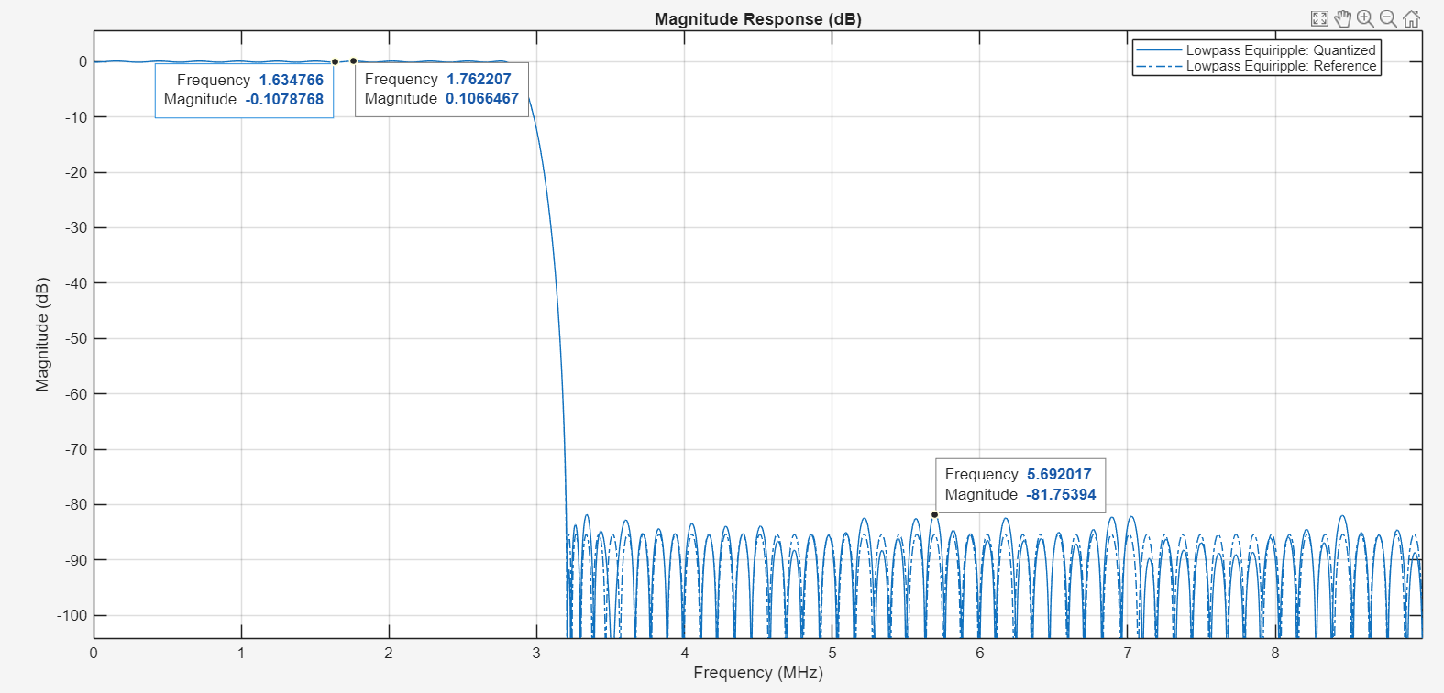
POLYPHASE
FRACTIONAL DECIMATOR
Passband ripple: ~0.2145 dB
Stop-band attenuation: ~81.754 dB
Narrow transition band: 2.8 - 3.2 MHz

Slide 6
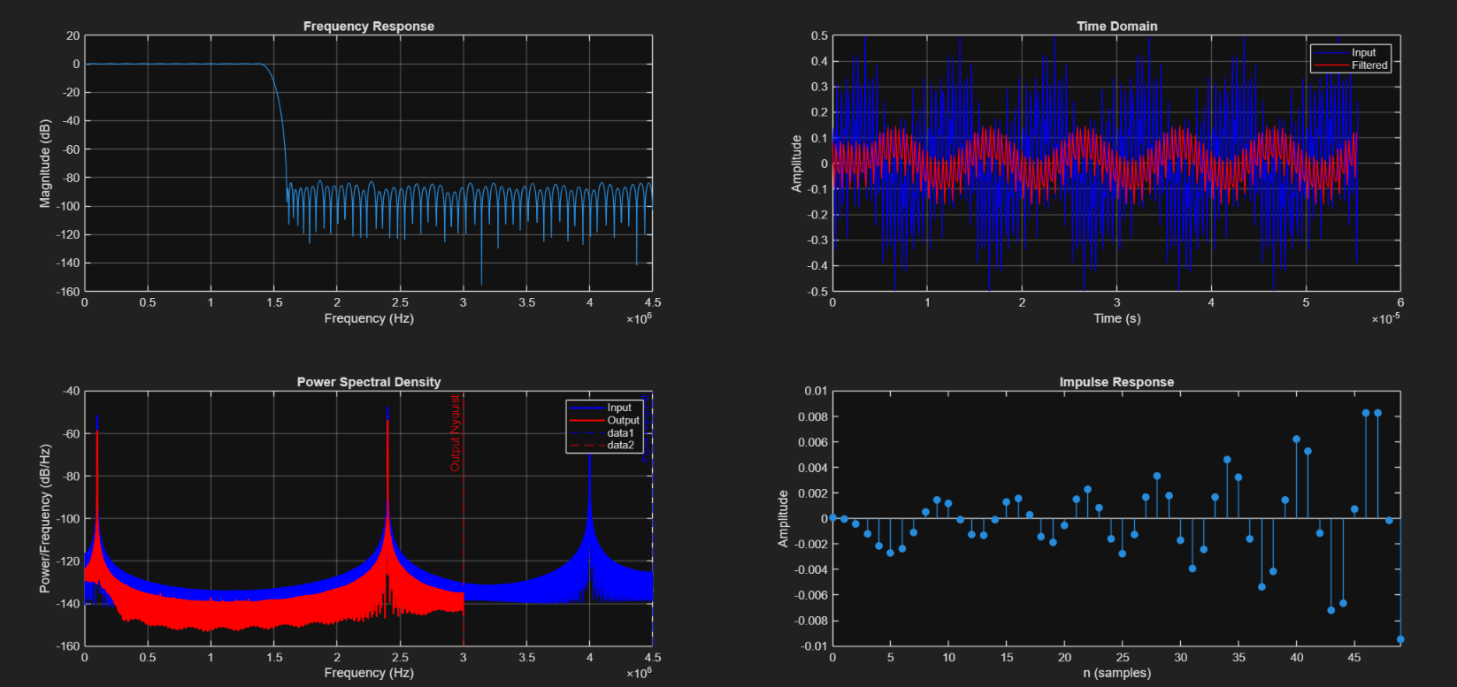
POLYPHASE
FRACTIONAL DECIMATOR

Slide 7
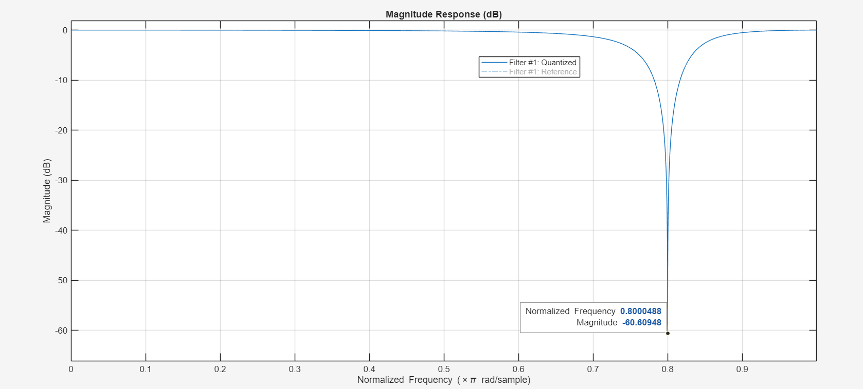
IIR
Notch depth: ~ -60.61 dB
BW: 50 KHz

Slide 8
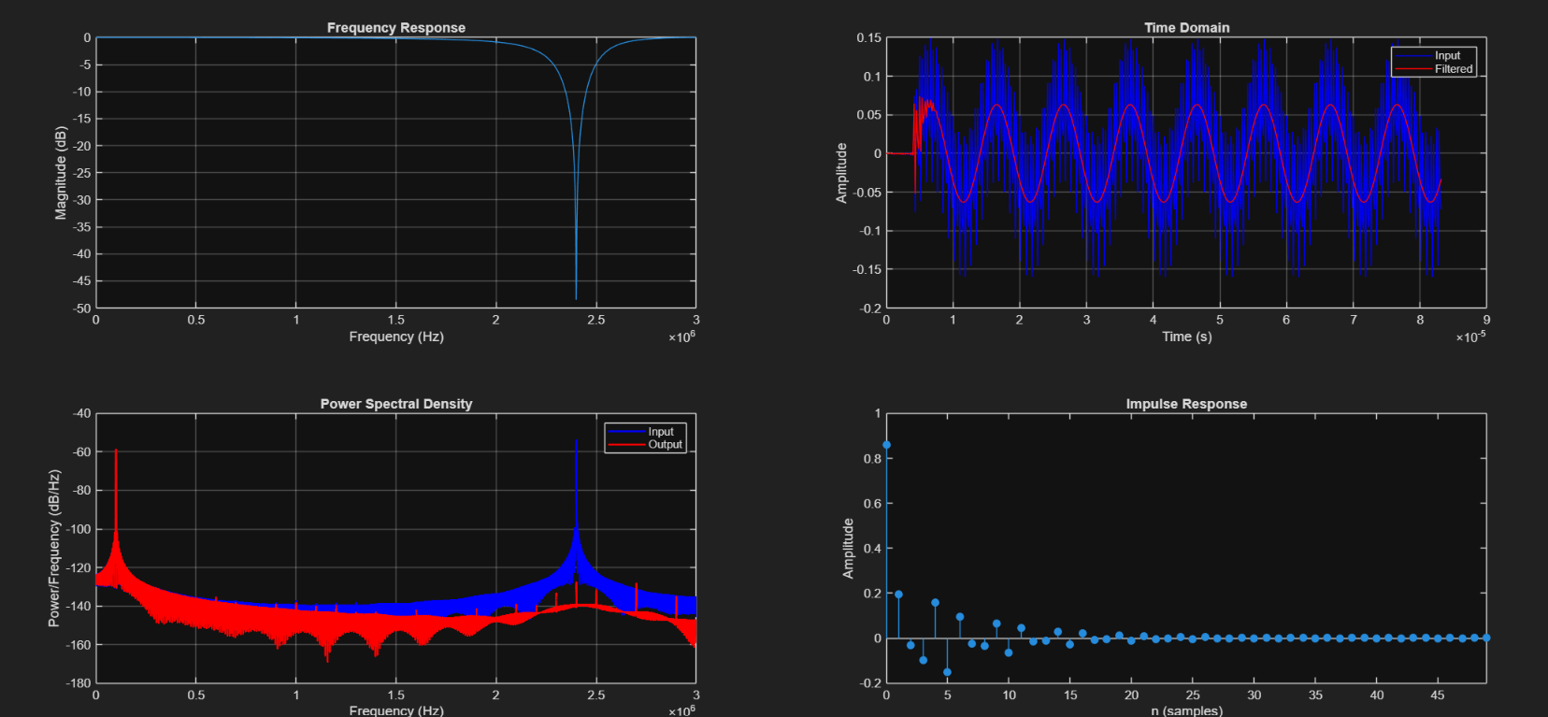
IIR

Slide 9
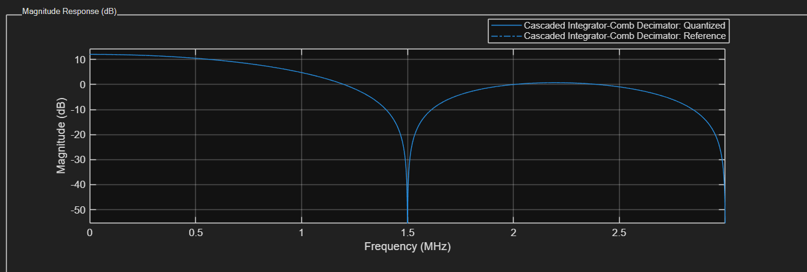
CIC
Number of Stages: 1
Differential Delay: 1
R: {2, 4, 8, 16}

Slide 10
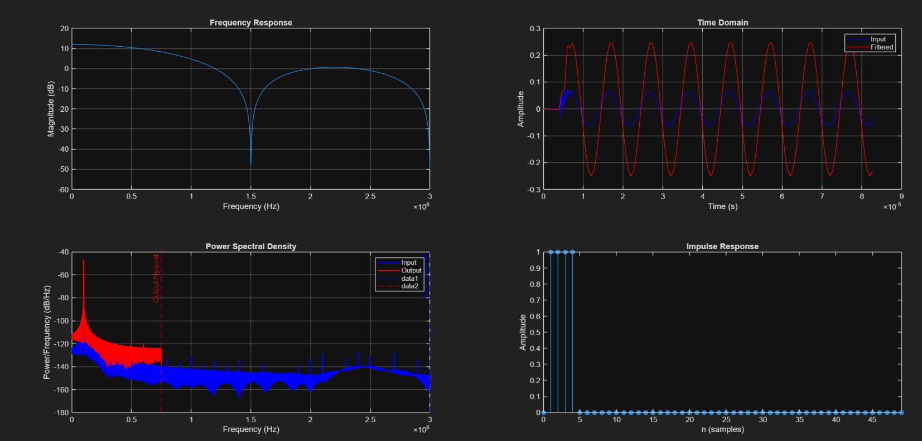
CIC

Slide 11
APB INTERFACE
Monitoring
Configuration

Slide 12
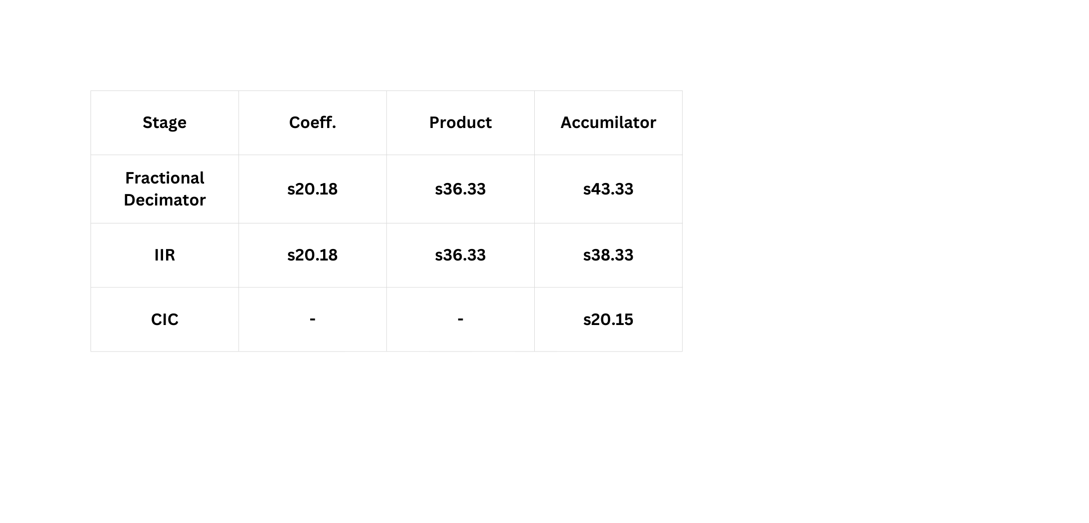
ARITHEMATICS
Product (Width / Fraction): DATA + COEFF
Accumulator Width: Product Width + clog2(gain)
Accumulator & Product: Same fraction length

Slide 13

PYTHON
TOOLING
Implements full DFE chain: Fractional Decimator → 2.4 MHz Notch → 5 MHz Notch → CIC
Supports fixed-point and floating-point processing (s16.15 for fixed)
Configurable via binary cfg.txt (bypass modes, CIC decimation factor)
Generates multiple test cases with interference, tones, and noise
Supports full-flow mode (decimation factors 2/4/8/16) and all bypass combinations
Writes per-stage outputs for testbench and MATLAB verification

Slide 14
CONFIGURATION
& TESTING
Test Case | Frequency | Amplitude | Shape | Interference | Tones | Noise
TC_1 | 100 KHz | 0.125 | Sine | ✘ | ✘ | ✘
TC_2 | 100 KHz | 0.125 | Sine | ✔ | ✘ | ✘
TC_3 | 100 KHz | 0.125 | Sine | ✔ | ✔ | ✘
TC_4 | 100 KHz | 0.125 | Sine | ✘ | ✘ | ✔
TC_5 | 100 KHz | 0.125 | Sine | ✔ | ✘ | ✔
TC_6 | 100 KHz | 0.125 | Sine | ✔ | ✔ | ✔

Slide 15
CONFIGURATION
& TESTING
Test Case | Frequency | Amplitude | Shape | Interference | Tones | Noise
TC_7 | 100 KHz | 0.9999 | Sine | ✘ | ✘ | ✘
TC_8 | 100 KHz | 0.9999 | Sine | ✔ | ✘ | ✘
TC_9 | 100 KHz | 0.9999 | Sine | ✔ | ✔ | ✘
TC_10 | 100 KHz | 0.9999 | Sine | ✘ | ✘ | ✔
TC_11 | 100 KHz | 0.9999 | Sine | ✔ | ✘ | ✔
TC_12 | 100 KHz | 0.9999 | Sine | ✔ | ✔ | ✔

Slide 16
CONFIGURATION
& TESTING
Test Case | Frequency | Amplitude | Shape | Interference | Tones | Noise
TC_13 | 50 KHz | 0.125 | Sine | ✔ | ✘ | ✔
TC_14 | 200 KHz | 0.125 | Sine | ✔ | ✘ | ✔
TC_15 | 50 KHz | 0.9999 | Sine | ✔ | ✘ | ✘
TC_16 | 200 KHz | 0.9999 | Sine | ✔ | ✘ | ✘

Slide 17
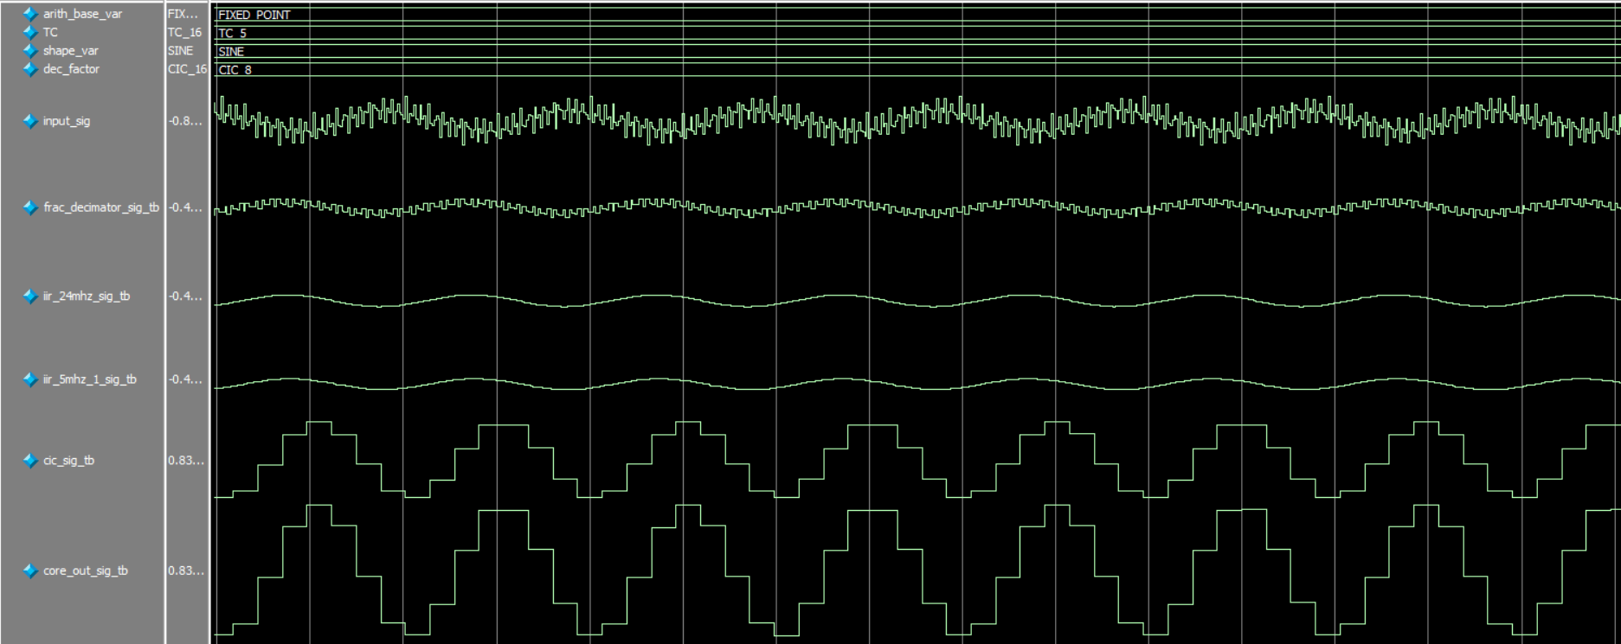
VERIFICATION
RESULTS
Fixed Point Sample

Slide 18
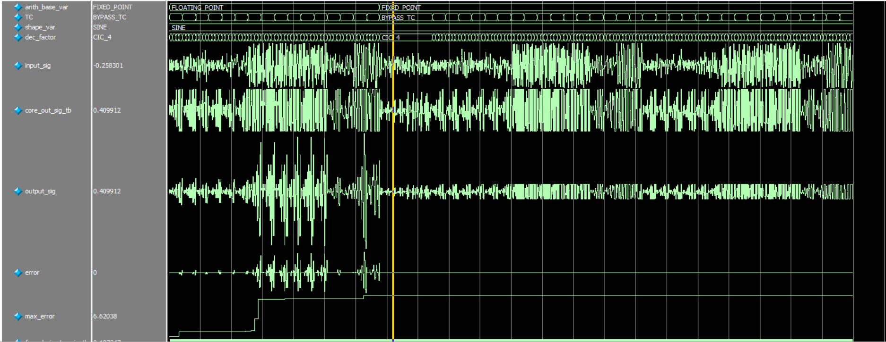
VERIFICATION
RESULTS
Floating Point

Slide 19
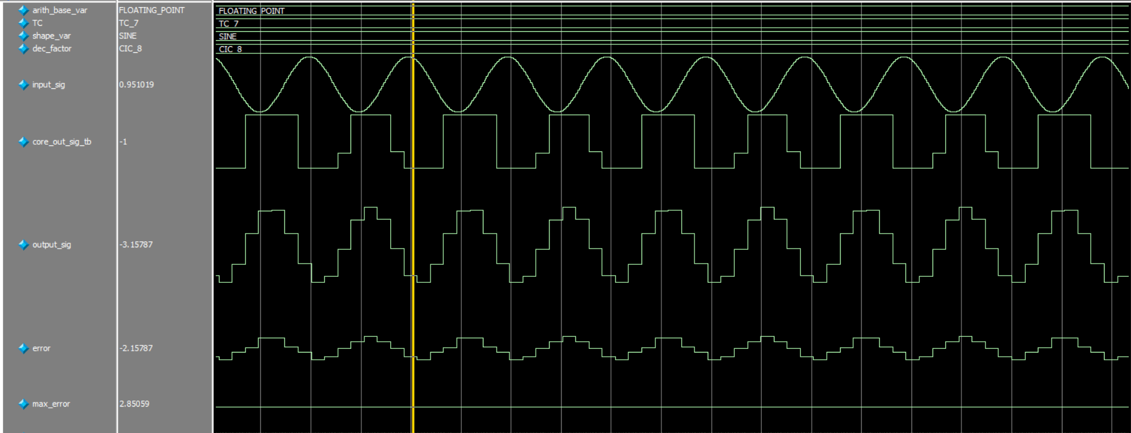
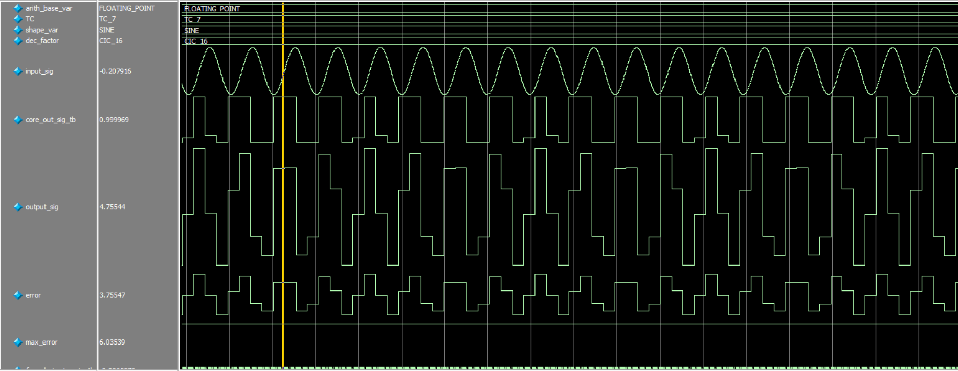
VERIFICATION
RESULTS
Floating Point
Max default amplitude error: 0.000248167
Max Error throughout simulations: 6.62038

Slide 20
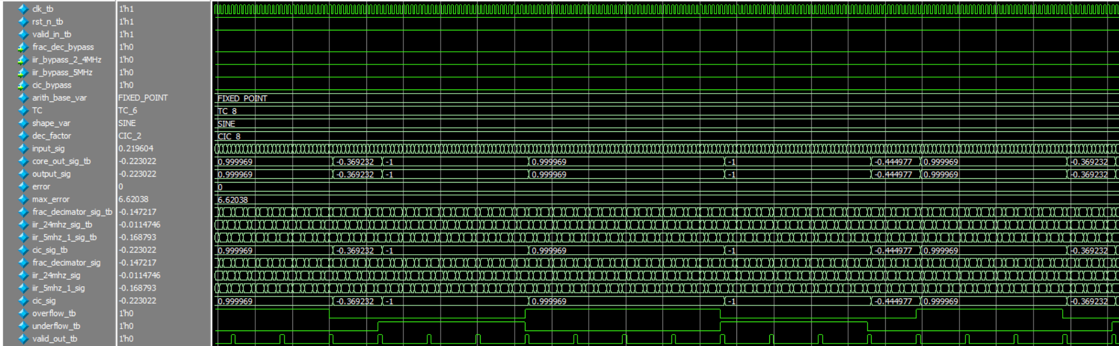
VERIFICATION
RESULTS
Status Behavior

Slide 21
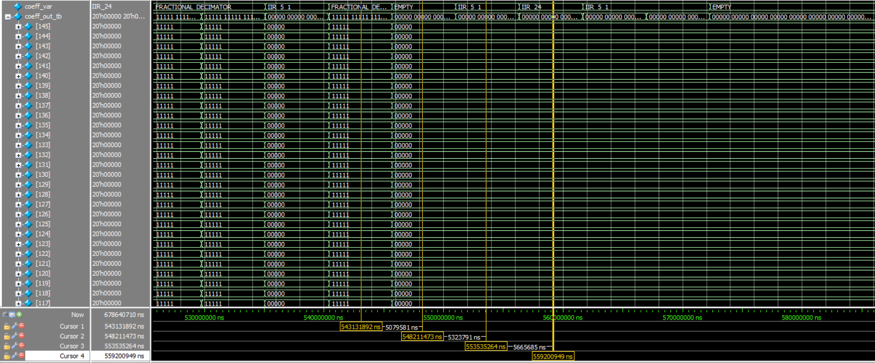
VERIFICATION
RESULTS
APB Point: COEFF.

Slide 22
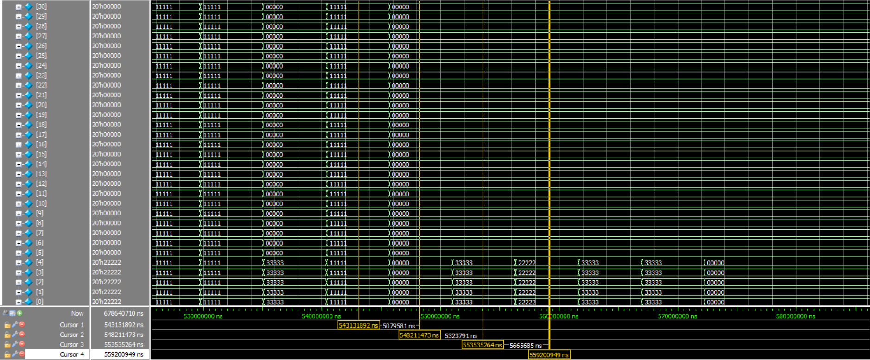
VERIFICATION
RESULTS
APB Point : COEFF.

Slide 23
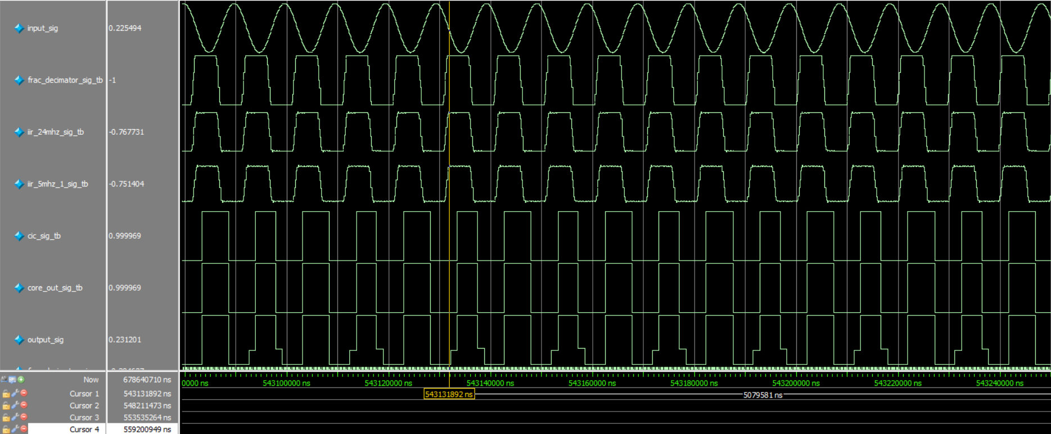
VERIFICATION
RESULTS
APB Point : COEFF. Behavior

Slide 24
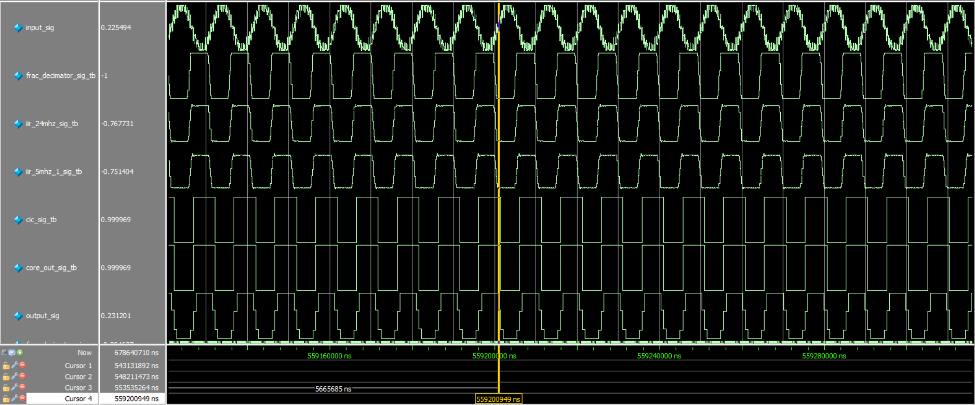
VERIFICATION
RESULTS
APB Point : COEFF. Behavior

Slide 25
VERIFICATION
RESULTS
APB Point : COEFF.

Slide 26
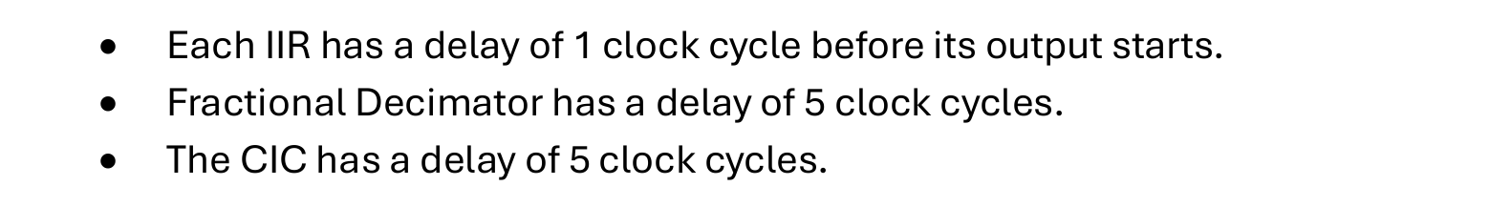
VERIFICATION
RESULTS
Total Latency 1.2µsec

Slide 27

MATLAB
INTEGERATION
Filter Modeling
Filter Analysis
SIR Calculations

Slide 28
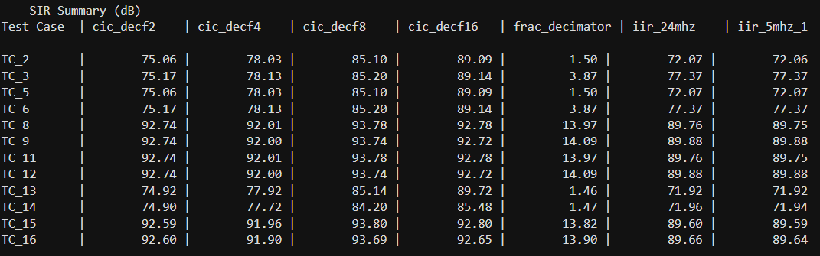
MATLAB
INTEGERATION

Slide 29
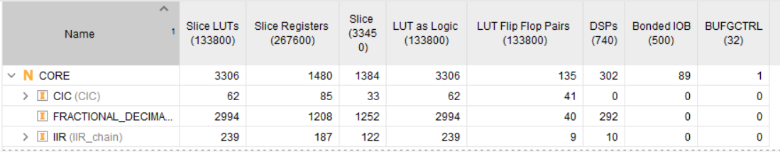
FPGA
Utility
INTEGERATION
HOW IS IT IMPLEMENTED AND TESTED?
Xc7a200t – Artix-7 FPGA

Slide 30
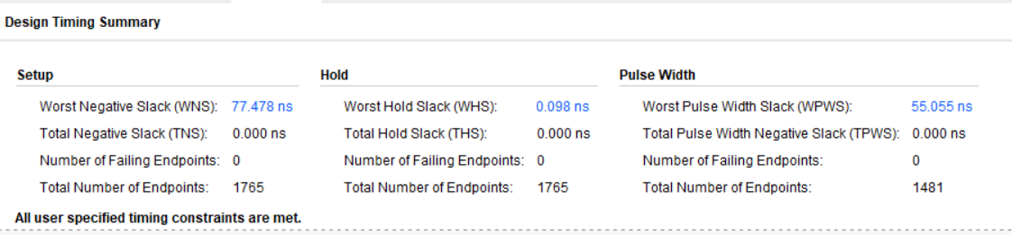
FPGA
Timing
INTEGERATION
HOW IS IT IMPLEMENTED AND TESTED?

Slide 31
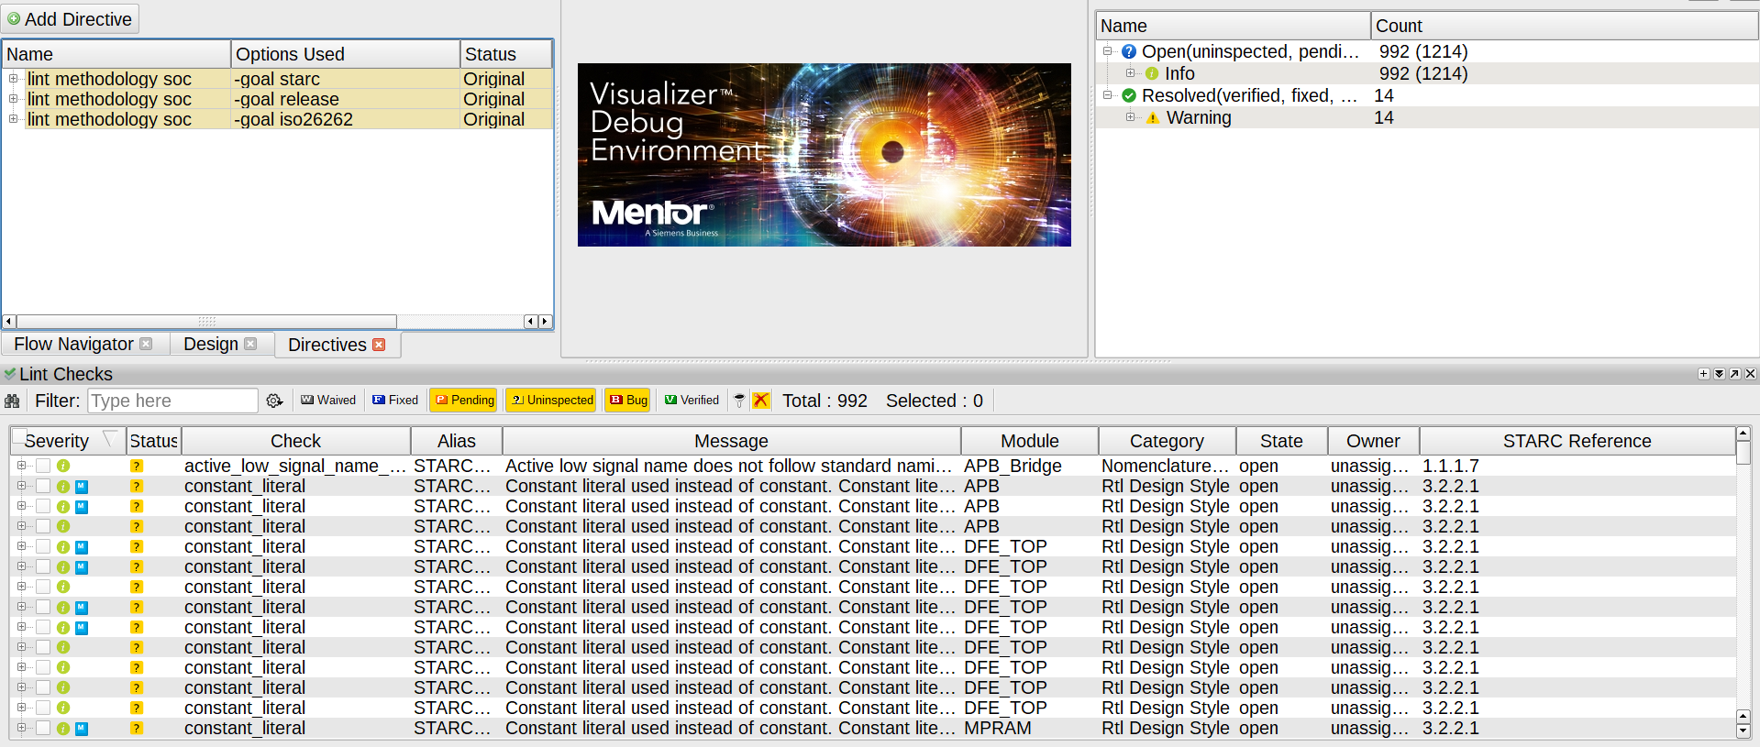
FPGA
INTEGERATION
Linting
HOW IS IT IMPLEMENTED AND TESTED?

Slide 32
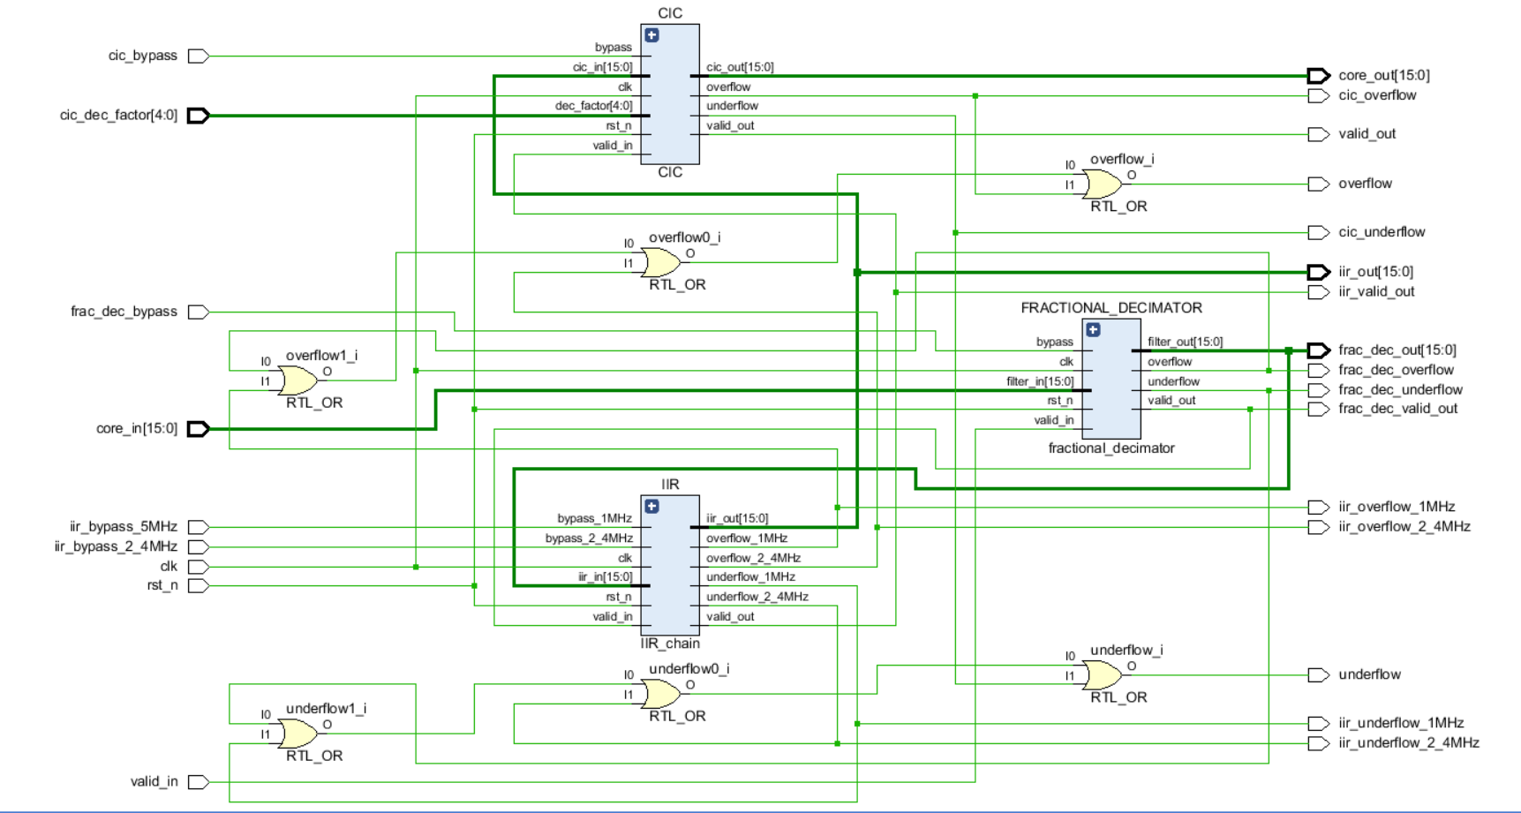
FPGA
INTEGERATION
Resulted Schematic
HOW IS IT IMPLEMENTED AND TESTED?

Slide 33
CHALLENGES
& LIMITATIONS

Slide 34
QUESTIONS?

Slide 35
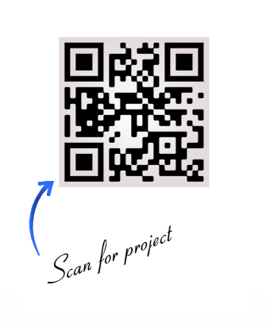
THANK
YOU
VIEW FULL PROJECT ON :
https://github.com/Mustafa11005/Multi_Stage_DFE.git

